Slide 1
Using Biomedical Ontologies to Retrieve Relevant Question Regarding Pregnancy in Community Question Answering Websites
Yu Lu, Xiao Luo, Zhan Zhang, Zhe He

Slide 2
Background
https://wiki.galenhealthcare.com/images/b/b6/Relay1.png
Notes:
With the adoption of patient portals, clinical data is becoming more accessible
Patients can access clinical data through patient portals

Slide 3
Background
Patients often have difficulties understand their clinical data because
1) clinical data is presented to patients the same way as it is shown to healthcare providers
2) medical jargons
3) patients may have insufficient health literacy
Hence they turn to online resources to fill their knowledge gap
Social Q&A sites
Health Forums

Slide 4
Community Question Answering sites
Why Q&A – interactivity, as compared to search engines
Why pregnancy
Health domain in Q&A emerging

Slide 5
Neural Information Retrieval
Traditional vs. Word Embedding
Notes:
A drawback of the traditional IR models is that they do not consider the semantic similarity of words. In response, the introduction of word embedding models addressed this limitation.

Slide 6
Research Gap
To date, prior work have not investigate how to support retrieving relevant medical questions concerned by the pre-pregnant, pregnant, and postnatal population.
https://cdn.styleblueprint.com/wp-content/uploads/2019/04/pregnancy-test.jpg
https://www.facemama.com/wp-content/uploads/2013/03/bigstock-pregnancy-motherhood-people-852404301-300x170.jpg
https://www.nct.org.uk/sites/default/files/2018-12/Mum%20cuddling%20baby%20looking%20worried.jpg

Slide 7
Methods
Human annotation of Yahoo! Answers question posts
Codebook presented in tree structure (themes + subnodes)
Tested a question-retrieval algorithm without ontologies
Develop and adopt pregnancy-specific ontologies to improve retrieval
Recruit female with pregnancy experiences for evaluation

Slide 8
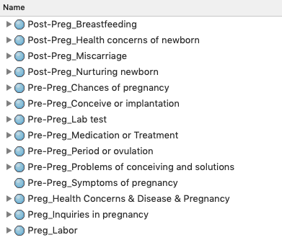
Methods - annotation

Slide 9
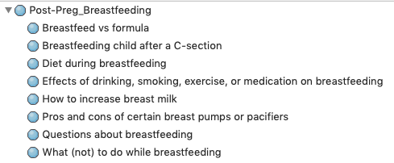
Methods - annotation

Slide 10
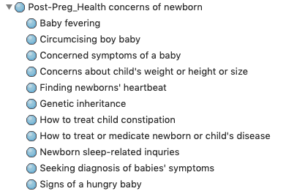
Methods - annotation

Slide 11
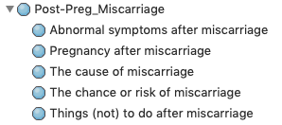
Methods - annotation

Slide 12
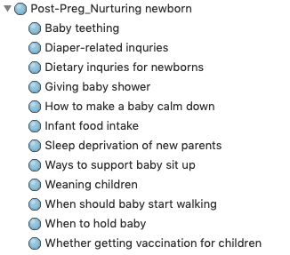
Methods - annotation

Slide 13
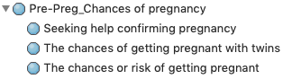
Methods - annotation

Slide 14
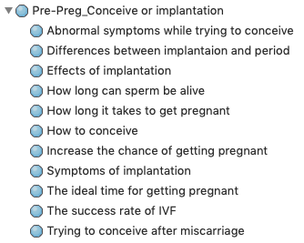
Methods - annotation

Slide 15
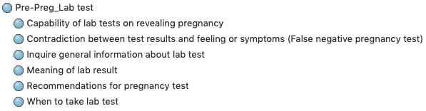
Methods - annotation

Slide 16
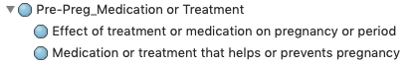
Methods - annotation

Slide 17
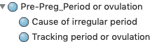
Methods - annotation

Slide 18
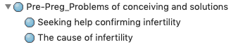
Methods - annotation

Slide 19
Methods - annotation

Slide 20
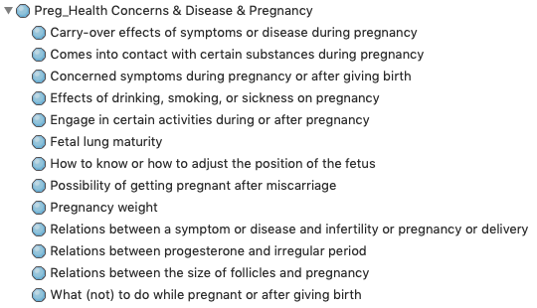
Methods - annotation

Slide 21
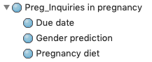
Methods - annotation

Slide 22
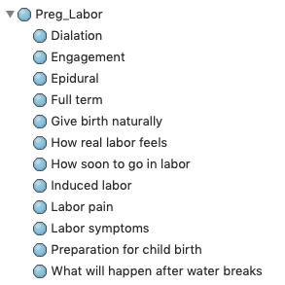
Methods - annotation

